Slide 1


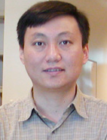

Hi-C
Erez Lieberman Aiden
Job Dekker
Bing Ren
Eric S. Lander
People, you should know:

Slide 2
Problems
Development of Hi-C
Correlation Analysis
Hi-C on the Chromosome Scale
Hi-C on the Genome Scale

Slide 3
Problems
Development of Hi-C
Correlation Analysis
Hi-C on the Chromosome Scale
Hi-C on the Genome Scale

Slide 4

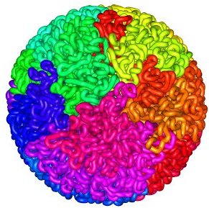
Development of Hi-C
The genome is three dimensional.
2 meters of DNA
The human genome contains approximately 3.16 billion DNA base pairs.
https://www.aidenlab.org/
Notes:
As depicted in basic biology textbooks and the public imagination, the human genome is packaged in bundles of DNA and protein on 23 chromosomes, arrayed in a neatly X-shaped form inside each cell nucleus.
But that's only true during the fleeting few moments when cells are poised to divide. The rest of the time, those chromosomes exist in a dense and ever-shifting clump. Of course their constituent DNA strings are clumped, too: If the genome could be laid out end-to-end, it'd be six feet long.
Far from being the random result of packing 2 metres of DNA into a sphere perhaps 10 micrometres across, the structures vary across cell types and exert an as-yet-mysterious influence on gene expression.

Slide 5
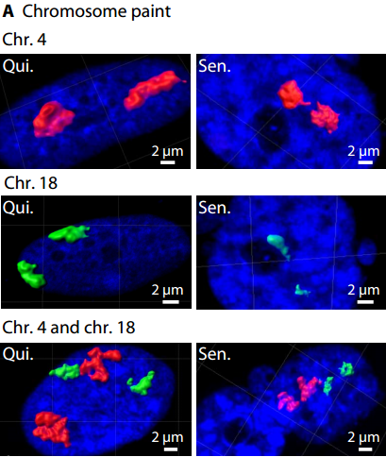
Microscope & FISH
Criscione S W, De Cecco M, Siranosian B, et al. Reorganization of chromosome architecture in replicative cellular senescence[J]. Science advances, 2016, 2(2): e1500882.
Notes:
Hi-C, chromosome conformation capture 3C, chromosome conformation capture carbon copy 5C, FISH

Slide 6
3D Organization of Genomes
Three-dimensional organization of genomes: interpreting chromatin interaction data from 3C to hi-C.
The family of chromosome conformation capture (CCC) techniques is a set of biochemical approaches to determine the physical interaction of genome regions.
CCC-technology approaches:
Invariably involve five wet-lab steps
Require computational analysis to determine interaction frequencies captured in the ligation of the crosslinked chromatin.
Notes:
CCC全称：染色体构象捕获

Slide 7
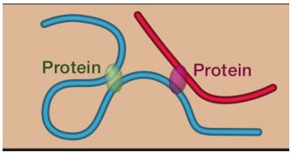
CCC: 1- Fixation
(1) Formaldehyde fixation to crosslink chromation at sites of physical interaction.
Hakim O, Misteli T. SnapShot: chromosome conformation capture[J]. Cell, 2012, 148(5): 1068-1068. e2.
Notes:
Formaldehyde甲醛固定

Slide 8
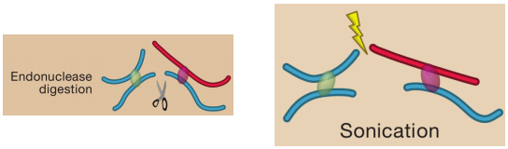
CCC: 2- Cleavage
(2) Cleavage of chromatin by restriction enzyme or sonication.
Hakim O, Misteli T. SnapShot: chromosome conformation capture[J]. Cell, 2012, 148(5): 1068-1068. e2.
Notes:
物理打断（超声破碎）和酶切打断基因组的区别：
超声破碎的话是随机的，酶切的话不是随机的，酶切位点是特定的。当然酶切时间和酶量都需要控制好。
只有CHIA-PET使用超声的方法切断

Slide 9
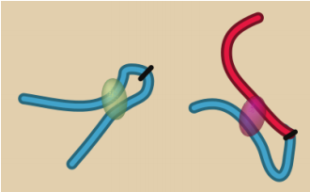
CCC: 3- Ligation
(3) Ligation under dilute conditions favoring ligation between DNA ends captured on the same complex (intramolecular ligation) over ligations from random collisions.
Hakim O, Misteli T. SnapShot: chromosome conformation capture[J]. Cell, 2012, 148(5): 1068-1068. e2.
Notes:
在稀释的条件下进行连接反应，有利于在随机碰撞的连接上捕获在相同复合物（分子内连接）上的DNA末端之间的连接。
Hi-C使用添加Biotin dCTP的方式连接，ChIP-loop使用免疫沉淀的方式连接，ChIA-PET使用免疫沉淀生物素化接头的方式连接。

Slide 10
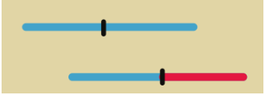
CCC: 4- Reverse crosslinks
(4) Reverse the formaldehyde-induced crosslinks.
Cross-links are reversed by heating, Proteinase K digestion, and phenol-chloroform extraction.
Hakim O, Misteli T. SnapShot: chromosome conformation capture[J]. Cell, 2012, 148(5): 1068-1068. e2.
Notes:
逆转甲醛诱导的交联
通过加热、蛋白酶K消化和苯酚-氯仿提取来逆转交联

Slide 11
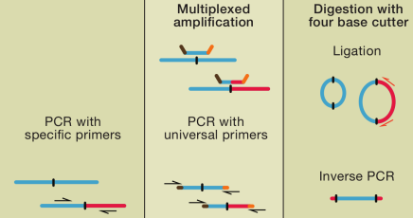
CCC: 5- Detection
(5) Detection of ligation junctions using variable molecular biology steps. Methodology depends on whether we are doing 3C, 4C, 5C, hi-C, etc.
Hakim O, Misteli T. SnapShot: chromosome conformation capture[J]. Cell, 2012, 148(5): 1068-1068. e2.
Notes:
3C，5C，4C分别用不同的分子生物学步骤检测连接。
具有特异性引物的PCR、多重扩增（具有通用引物的PCR）、用四个碱基切除消化（反向PCR）

Slide 12
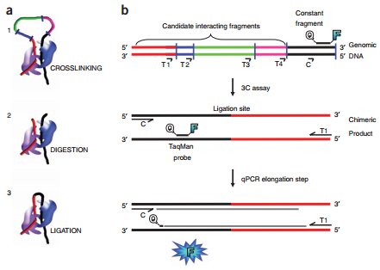
CCC: 3C
3C: the simplest CCC technology. We use one targeted quantitative PCR (Q-PCR) for each interaction we want to measure.
Shown here: constant fragment (black segment) and candidate interacting fragments (red, blue, green and pink segments). Restriction sites that will be used in the 3C assay are depicted as small vertical bars in blue.
Hagège H, Klous P, Braem C, et al. Quantitative analysis of chromosome conformation capture assays (3C-qPCR)[J]. Nature protocols, 2007, 2(7): 1722.
Notes:
恒定片段用黑色的片段表示
候选互作片段用红色、蓝色、绿色以及粉色片段表示
蓝色的小垂直条用用以表征3C实验中所用到的限制性酶切位点

Slide 13
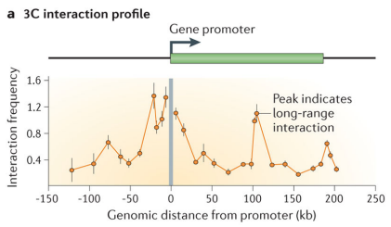
CCC: 3C
3C data for the CFTR gene. Interaction frequencies between the promoter (grey bar) and various other regions are measured with specific Q-PCR primer combinations. Peaks suggest increased frequency, ergo, substantial interaction between the promoter and some distant element.
Genomic proximity ligation
Tests any pair of loci
Not large scale
Dekker J, Marti-Renom M A, Mirny L A. Exploring the three-dimensional organization of genomes: interpreting chromatin interaction data[J]. Nature Reviews Genetics, 2013, 14(6): 390.
Notes:
基因组邻近连接
测试任何一对基因座
小规模

Slide 14
Improvemens to 3C
 | Scale | Year
3C | 1 locus * 1 locus PCR | Dekker, 2002
4C | 1 * All Inverse PCR (from known locus) | Zhao, 2006
5C | ~1000 * ~ 1000 Multiplex PCR | Dostie, 2006
Hi-C | All * All No locus-specific PCR | Aiden, 2009
https://vimeo.com/7019500
But the full problem is 3 billion * 3 billion!

Slide 15
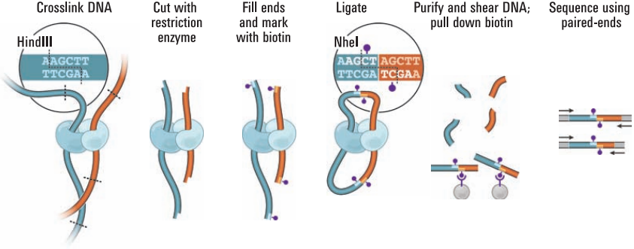
Genome-wide Chromosome Conformation Capture
Hi-C enables an all-versus-all interaction profiling.
Lieberman-Aiden E, Van Berkum N L, Williams L, et al. Comprehensive mapping of long-range interactions reveals folding principles of the human genome[J]. science, 2009, 326(5950): 289-293.
Biotin
No locus-specific primers!
Notes:
因为我们使用了生物素进行标记，因此，我们不需要位点特异性的引物去获得连接区域。
Here, two spatially adjacent chromation segments (blue/orange) are connected by protein-protein interactions.
They are crosslinked by formaldehyde and digested by HindIII (aaactt).甲醛交联+Hind3酶消化

Slide 16
Hi-C: Methodology
HindIII digestion leaves a four-nucleotide overhang on the restriction fragments
5’ – AGCTT – 3’
3’ – A – 5’
This cleavage provides a template for labeling the restriction fragments with biotin-14-dCTP
The overhang is filled in by the Klenow fragment of DNA polymerase I using equimolar amounts of all deoxyribonucleotides with the substitution of biotin-14-dCTP for dCTP.
Processing by the Klenow fragment results in two fragments with blunt ends that are still cross-linked to one another.
They are ligated to one another in a dilute solution that favors intra-molecular ligation.
The ligation of two filled in HindIII sites results in a new Nhel site (5’-GCTAGC-3’).
Process fragments with proteinase K at 65 ℃.
Purify/shear DNA, pull down with streptavidin beads.
Illumina paired-end sequencing (50bp).
Notes:
HindIII酶切之后，在限制性片段上留下一个四碱基的粘性突出末端
Equimolar等摩尔量的
Streptavidin beads链霉磁珠

Slide 17
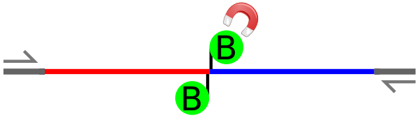
Hi-C: Sequence Read Mapping/Filtering
Paired end sequencing of the two fragments
Optimally, we pull down a fragment that is biotin-marked at the ligation point of two distinct fragments.
We can now count the number of times distinct paired of genomic regions are connected.

Slide 18
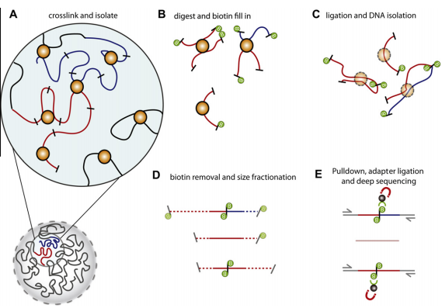
Hi-C: Artefacts
Overview of Hi–C technology
Belton J M, McCord R P, Gibcus J H, et al. Hi–C: a comprehensive technique to capture the conformation of genomes[J]. Methods, 2012, 58(3): 268-276.
Notes:
有效互作对
自连
再连
我们再回顾一下刚刚的步骤：1.甲醛交联，固定细胞核内染色质构象2.酶切，并用生物素标记3.成环4.打断5.钓取带有生物素标记的酶切片段

Slide 19
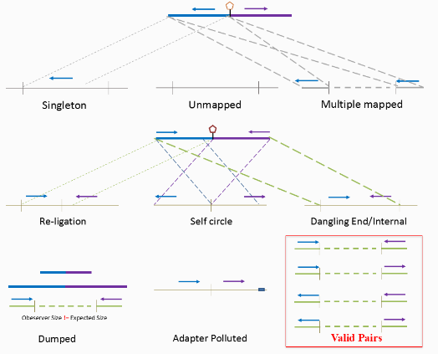
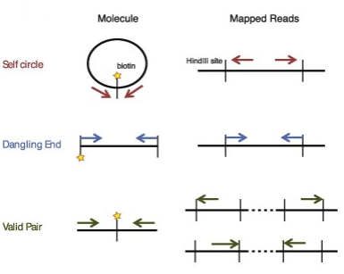
Hi-C: Artefacts
If two reads come from the same HindIII fragment, it represents an artefact.
Self circle: self-circularized ligation product.
Dangling end: An unligated product.
Belton J M, McCord R P, Gibcus J H, et al. Hi–C: a comprehensive technique to capture the conformation of genomes[J]. Methods, 2012, 58(3): 268-276.
Notes:
只有来自不同的read的头对头或者尾对尾才是我们需要的read
其余的两种情况：read自连和没有连接上都不是我们想要的
因此在分析过程中会将部分无效的数据进行过滤，首先是如果两个片段原本通过一个酶切位点连接在一起，在Hi-C文库中如果该片段即使酶切后添加生物素仍然连接在一起，该片段会被归类到Re-ligation reads中；而如果两个的reads比对到同一个fragment，但是方向相反，则该reads会被认为是首尾相连形成了Self-circle ；如果pair end 同时比对到一个酶切片段上，则该片段会被认为是Dangling ends；如果有一个发现是adapter污染，该reads会被认为是Adapter polluted；如果两侧的end均能比对到基因组的两个酶切片段中，但是观测到的片段大小与理论的片段大小不一致，则该片段会认为是错误连接而被归类为Dumped reads；只有比对到两个酶切片段且片段的理论值等于实际值的reads，才会被认为是Valid pair reads。

Slide 20
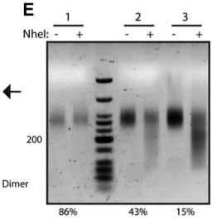
Hi-C: Quality control
Recall that HindIII digestion leaves us with the overhang AGCT. If two such overhangs are filled in and then blunt-end ligated, we obtain a new Nhel site: 5’-GCTACG-3’.
The shift of the size distribution of the library following digestion with Nhel estimates the proportion of the library that consists of real Hi-C ligation products.
Here: library 1 → poor performance, library 2 → medium performance and library 3 → good performance.
Belton J M, McCord R P, Gibcus J H, et al. Hi–C: a comprehensive technique to capture the conformation of genomes[J]. Methods, 2012, 58(3): 268-276.
Notes:
最后的质量控制以及文库的量：
通常情况下，大部分文库由约10-45%的dangling ends组成。如果文库中存在大于80%的片段是dangling ends，那么将不利于测序。

Slide 21
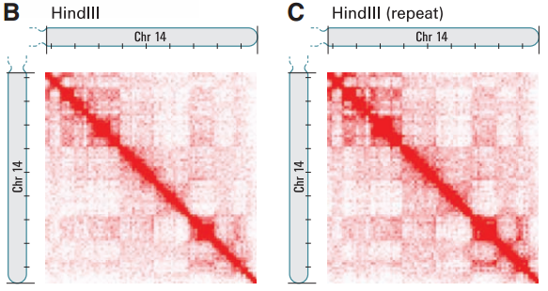
Hi-C generates genome-wide contact maps
geneA
geneB
Unbiased genome-wide analysis
Heat map shows contact matrix for chromosome 14
Intensity = # of reads
Many local interactions → Intense diagonal!
geneA
Lieberman-Aiden E, Van Berkum N L, Williams L, et al. Comprehensive mapping of long-range interactions reveals folding principles of the human genome[J]. science, 2009, 326(5950): 289-293.
Notes:
Chr14： Two independent biological replicates.

Slide 22
Problems
Development of Hi-C
Correlation Analysis
Hi-C on the Chromosome Scale
Hi-C on the Genome Scale
Notes:
数据分析：
1.数据过滤筛选（二代测序通用）2.比对：比对的方式主要分两种：一种判断每条reads是否含有酶切位点，有则去掉酶切位点之后的数据再进行bowtie2单端比对；另一种则采用单端比对的策略，以25bp为起始长度，每次增加5bp直到该reads比对到基因组具有唯一性3.寻找酶切片段；比对寻找到read pairs在基因组物理位置之后，通过插入片段大小的限制搜索read pairs两端每条read所对应的最近的酶切片段。酶切片段的位置代表了DNA交互产生的大致位置4.筛选fragment pairs，我们不要self circle和dangling end，只要valid pair.5.binning；将valid pairs的交互信息mapping到基因组的位置，最终转换成为每两个bin的交互强度6.交互矩阵标准化；标准化的方法主要分为两类，一类是基于矩阵，进行数学上的标准化，例如迭代等，另一类是基于生物学意义（例如mapping ability）上的标准化

Slide 23
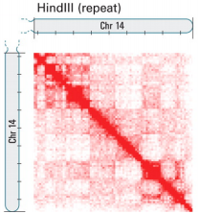
Hi-C: Computational analysis
Basic analysis strategy: divide the genome into 1Mb regions, and define the matrix entry m_{ij} to be the number of ligation products between region i and region j.
The figure represents the contact matrix M for chromosome 14 as a heatmap.
Lieberman-Aiden E, Van Berkum N L, Williams L, et al. Comprehensive mapping of long-range interactions reveals folding principles of the human genome[J]. science, 2009, 326(5950): 289-293.

Slide 24
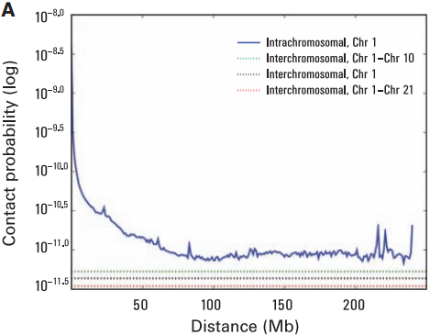
Hi-C: Computational analysis
Hi-C can be used to investigate the organization of chromsome territories.
We will call the 1Mb regions ‘loci’.
Let I_{n}(s) be the average intrachromsomal contact probability on chromosome n for pairs of loci separated by a genomic distance s.
Probability of contact decreases with genomic distance.
Intrachromsomal contacts more common than interchromosomal.
Lieberman-Aiden E, Van Berkum N L, Williams L, et al. Comprehensive mapping of long-range interactions reveals folding principles of the human genome[J]. science, 2009, 326(5950): 289-293.

Slide 25
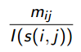
Hi-C: Computational analysis
We define a normalized contact matrix M* by dividing each entry of the contact matrix M by the genome wide average contact probability for loci at that genomic distance.
For loci i and j, which are at a distance of s(i,j) to one another, the element of M* is thus
The normalized matrix shows many patterns that were less apparent in the original matrix.

Slide 26
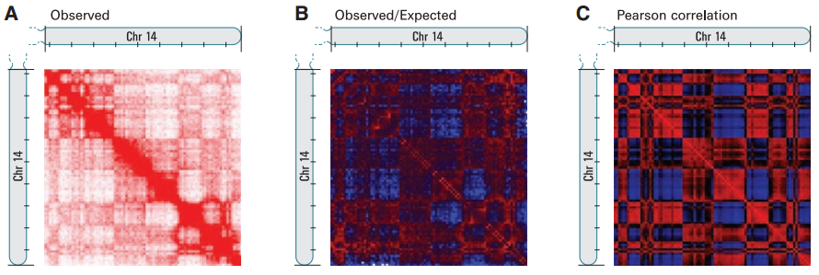
Hi-C: Computational analysis
O/E matrix: loci with either more (red) or less (blue) interactions than expected given their genomic distance.
Pearson matrix: Correlation between the intrachromosomal interaction profiles for every pair of 1Mb loci.
The plaid pattern indicates two compartments within the chromsome.
Lieberman-Aiden E, Van Berkum N L, Williams L, et al. Comprehensive mapping of long-range interactions reveals folding principles of the human genome[J]. science, 2009, 326(5950): 289-293.
Notes:
在figure2中，红色表示enriched，蓝色表示depleted，白色表示no data
Proximity→Ligation Junctions
Plaid pattern：figure3里面的格子花模式，strong correlation：red→red and blue→blue; strong anti-correction: red->blue and blue→red.

Slide 27
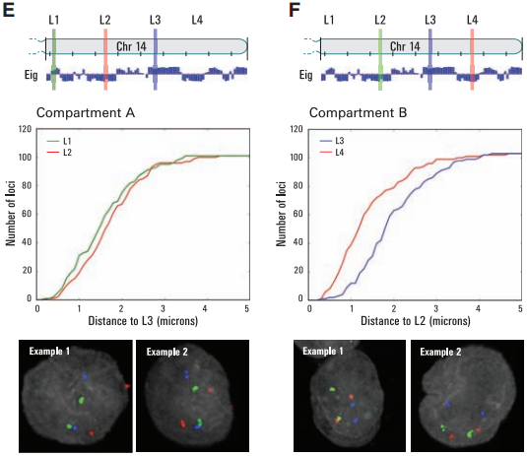
Hi-C: Computational analysis
plaid patterns were consistently seen for all chromosomes. The labels A and B could be assigned so that sets on each chromosome with the same label had correlated contact profiles.
These results imply that the genome can be divided into two spatial compartments.
3D-FISH
Lieberman-Aiden E, Van Berkum N L, Williams L, et al. Comprehensive mapping of long-range interactions reveals folding principles of the human genome[J]. science, 2009, 326(5950): 289-293.
Notes:
(E) probes L1 and L3 (compartment A) are close to one another than to L2 (compartment B).对于FigureE来说，蓝绿更加接近。
(F) probes L2 and L4 (compartment B) are close to one another than to L3 (compartment A).对于FIgureF来说，红绿更加接近。
Hi-C数据暗示着：如果各个区域属于相同的compartment（A或者B），那么它们在空间上趋向于更加接近。为了证明这件事情，我们使用3D-FISH实验来探究14号染色体上面的四个位点（L1，L2，L3和L4）在两个compartment上面的改变（L1和L3属于compartmentA；L2和L4属于compartmentB）。3D-FISH的结果显示：尽管对于线性基因组来说，L2存在于L1和L3之间，但是L3更倾向于与L1接近（比起L2）。

Slide 28
Hi-C: Computational analysis
Compartment A correlates strongly with the presence of
Genes
Higher expression
Accessible chromation activating (H3K36 trimethylation) and repressive (H3K27 trimethylation) chromation marks.
Thus, compartment A is more closely associated with open, accessible, activately transcribed chromatin.

Slide 29
Normalizing Hi-C data
In Hi-C, the frequency of chromatin interaction is represented by the number of paired-end reads linking two genomic sequences. In principle, higher counts indicate increased frequency of chromatin interaction and closer spatial distance between the two sequences, but systematic biases in the data can greatly affect interpretation.
In the remaining time, we will examine the reasons for these biases and then present a methodology that uses a generalized linear model to correct for bias.

Slide 30
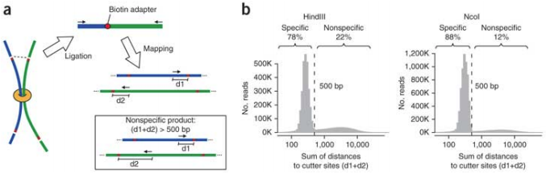
Systematic biases in Hi-C data
Note here that most of the reads are located with 500bp of the HindIII (or Ncol) restriction sites.
This is as expected given that the size selection parameter in the experiment was 500bp.
However, there are additional reads distributed nearly uniformly across the entire fragment – likely to represent artifacts.
Yaffe E, Tanay A. Probabilistic modeling of Hi-C contact maps eliminates systematic biases to characterize global chromosomal architecture[J]. Nature genetics, 2011, 43(11): 1059.

Slide 31
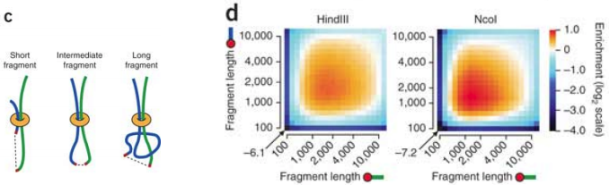
Systematic biases in Hi-C data
(c) Length of restriction fragments (in other words, the distance between adjacent cutter sites) represents another source of bias.
For example, long and short fragments may have variable ligation efficiencies or compete differently on ligations with cis and trans fragment ends.
(d) Restriction fragment lengths are indeed correlated with trans-contact probabilities.
Yaffe E, Tanay A. Probabilistic modeling of Hi-C contact maps eliminates systematic biases to characterize global chromosomal architecture[J]. Nature genetics, 2011, 43(11): 1059.

Slide 32
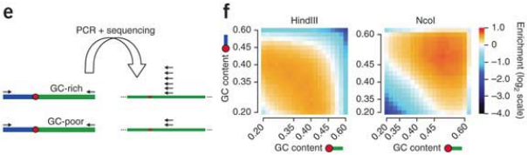
Systematic biases in Hi-C data: G/C content
A known major source of bias in sequencing experiments is the nucleotide composition of the DNA under study.
G/C content had a major effect on the Hi-C data, but in different ways for HindIII and Ncol data.
Yaffe E, Tanay A. Probabilistic modeling of Hi-C contact maps eliminates systematic biases to characterize global chromosomal architecture[J]. Nature genetics, 2011, 43(11): 1059.

Slide 33
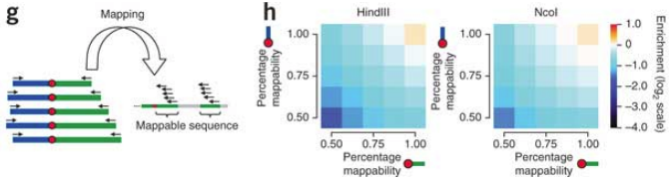
Systematic bias in Hi-C data: Mapability
Mapability is predicted and confirmed to have a linear effect on the estimated trans-contact probabilities.
Yaffe E, Tanay A. Probabilistic modeling of Hi-C contact maps eliminates systematic biases to characterize global chromosomal architecture[J]. Nature genetics, 2011, 43(11): 1059.

Slide 34
Poisson regression: GLMs
In the final section of this introduction, we will examine a method called HiCNorm, which is a normalization approach for removing biases in Hi-C data via Poisson regression. We will first introduce the topic of generalized linear model, Poisson regression, and then show how it was used to allow an efficient and effective normalization of Hi-C data.
Notes:
广义的线性模型

Slide 35
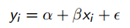
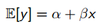
Generalized linear models (GLM)
The simple straight-line regression model has the form:
The regression model can be written, equivalently
(1)
(2)

Slide 36
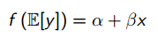
Generalized linear models (GLM)
GLM is a generalization of equation (2), which allows a transformation of the left-hand side of the equation. In other words:
The result specifices a linear realtion with x. The function f(.) is called the link function; common examples of link functions are f(x)=x, f(x)=1/x, f(x)=log(x) and f(x)=log(x/(1-x)) (the latter function is the logic link).
Note all of these functions are monotonic.
(3)
Notes:
线性单调（单调递增或者单调递减）关联函数

Slide 37
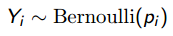
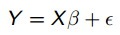
Generalized linear models (GLM)
Let us begin with a simple example. Categorical (yes/no) responses do not fit naturally into the framework linear regression, which assumes normally distributed responses.
Suppose we are modelling some response (Y) that is categorical yes/no according to a Bernoulli distribution
This is in contrast to the assumption of linear regression: Y_{i}~Normal(u_{i}, δ), which corresponds to the least squares equation
Where β is a k*1 vector of unknown parameters and is an n*1 vector of unobserved disturbances.
(4)
(5)
Notes:
Bernoulli伯努利分布，又称为两点分布或者0-1分布
Normal正态分布
二项分布有两个参数：一个n表示试验次数，一个p表示一次实验成功概率。
现在考虑一列二项分布，其中试验次数n无限增加，而p是n的函数。
如果np存在有限极限λ，则这列二项分布就趋于参数为λ的泊松分布。反正，如果np趋于无限大（如p是一个定值），则根据德莫佛-拉普拉斯(De’Moivre-Laplace) 中心极限定理，这列二项分布将趋近于正态分布。
实际运用中当n很大时，一般都用正态分布来近似计算二项分布，但是如果同时np又比较小（比起n来说很小），那么用泊松分布近似计算更简单些，毕竟泊松分布跟二项分布一样都是离散型分布。

Slide 38
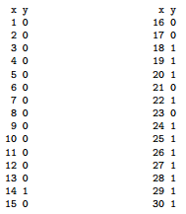
Generalized linear models (GLM)
Lets imagine we have data with y∈{0,1} and x∈Z⁺.
Let’s say we’re feeling really stupid today and decide to do standard linear regression (which is equivalent to GLM with an identity link function)
Notes:
Bernoulli伯努利分布，又称为两点分布或者0-1分布
伯努利分布举例子
X属于正整数，y是二值的

Slide 39
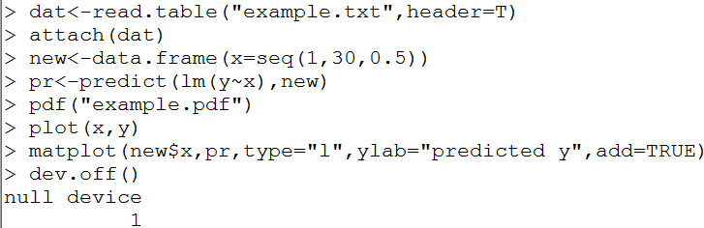
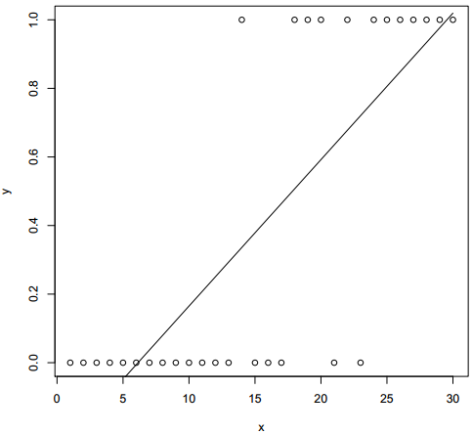
Generalized linear models (GLM)
Notes:
简单的线性回归：x作为解释变量；y作为被解释变量
Yi=B0+B1Xi+ei
B0和B1是回归系数，ei是误差项

Slide 40
Dumb regression
The scatter plot on the previous slide is almost impossible to interpret (There is some relationship between y=1 and high x values compared to low x values, but it’s impossible to see much else, much less to visualize the correct regression line).
The predicted values for y are not even constrained to be within [0, 1].
The only reasonable solution would seem to be giving up our assumption of normality.
Briefly, the GLM used for two-category response variables involves the logit link.
Notes:
简单回归存在一些问题：
1.难以用拟合的直线去解释这些散点（相比于低的x值，高的x值与y=1更相关，但是从这个拟合曲线上面却看不到）
2.y的预测值甚至超出了[0,1]这个范围
3.唯一合理的解决方案似乎是放弃我们正常的假设
4.简而言之，我们把广义的线性回归模型用于涉及到罗杰斯特链接的两类响应变量

Slide 41
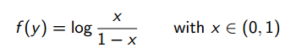
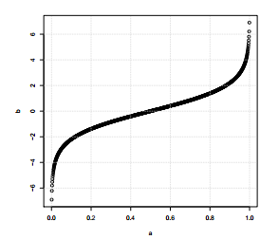
Bernoulli regression
The logit link is defined as:
(6)

Slide 42
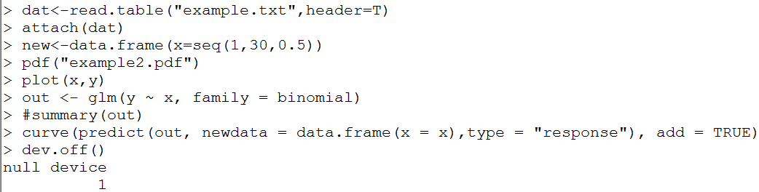
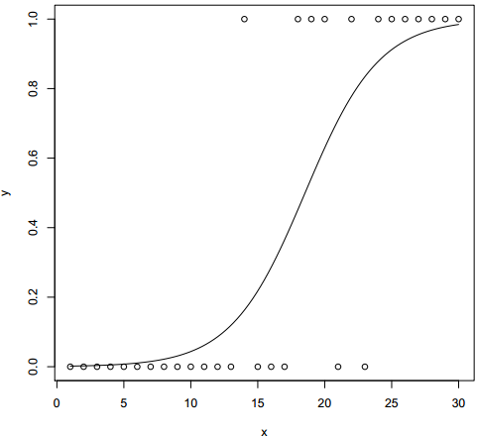
Bernoulli regression
In R, we can code Bernoulli GLM as

Slide 43
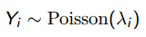
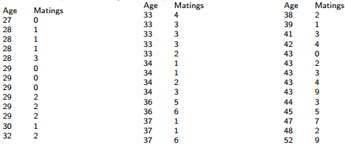
Poission regression
Poission regression is also a type of GLM where the response varibale is a count
Imagine we are naturalists in Kenia and have data on the number of matings for Bull elephants arranged according to age. The age of the elephant at the beginning of the study and the number of successful matings during the 8 years were recorded. We assume the number of matings follows a Poisson distribution, where the mean depends on the age of the elephant in question.
(7)

Slide 44
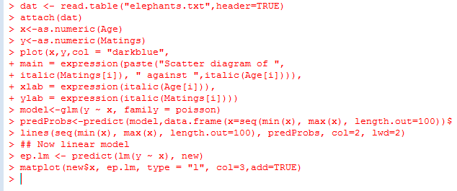
Poisson regression
Here we see Poisson regression (GLM) in red v.s. standard linear regression in green.

Slide 45
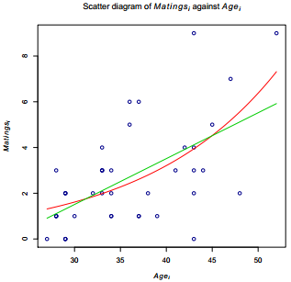
Poisson regression

Slide 46
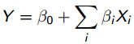
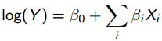
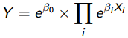
Poisson regression
Recall that in linear regression, if the response variable has a normal distribution, its mean can be linked to a set of explanatory variables using a linear function:
If the response variable is a count (all positive integers), the Possion is more appropriate. The logarithm of the response variable is linked to a linear function of response variables
equivalently
(8)
(9)
(10)

Slide 47
Poisson regression
In other words, Possion regression expresses the log outcome as a linear function of a set of predictors.
Assumptions:
Logarithm of the response rate changes linearly with equal increment increases in the exposure variable.
Changes in the rate from combined effects of different exposures or risk factors are multiplicative.
At each level of the covariates the number of cases has variance equal to the mean.
Observations are independent.
Notes:
泊松回归将对数结果表示为一组预测变量的线性函数
假设：
响应速率的对数随着曝光变量的相等增量而线性变化
不同暴露或者风险因素的综合影响率的变化是乘法的
在协变量的每个级别，案例的数量具有等于均值的方差
每个观察是相互独立的

Slide 48
HiCNorm
HiCNorm uses three local genomic features to predict the Hi-C read count via Poisson regression, using this to correct the raw counts before downstream analysis.
The genome is divided into 1Mb bins, where L_{i}^{j} is the jth bin on chromosome i. For each such bin, three attributes are measures
Effective length
GC content
Mapability
Hu M, Deng K, Selvaraj S, et al. HiCNorm: removing biases in Hi-C data via Poisson regression[J]. Bioinformatics, 2012, 28(23): 3131-3133.
Notes:
Compared with the existing Hi-C normalization method developed by Yaffe and Tanay, HiCNorm has fewer parameters, runs >1000 times faster and achieves higher reproducibility.
和其他已存在的Hi-C数据标准化方法（由Yaffe和Tanay开发的方法）相比，HiCNorm需要的参数更少，运行速度更快，数据重现性更高。

Slide 49
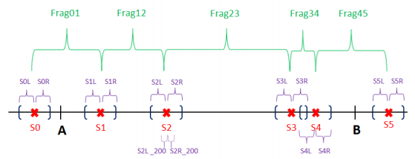
HiCNorm
A-B represens one genomic locus (i.e., 1Mb bin).
6 restriction sites (red cross) partition the genomic region into consecutive, disjoint fragments.
The fragment end is the 500bp genomic region next to the restriction site (Frag01, …). Effective length is sum of fragment ends minus overlap.
GC content is calculated within a 200bp region upstream (e.g., S2L_200 and S2R_200).
Mappability: create 55 subsequences (36bp each) in 50 bp around restriction site. Calculate percentage of uniquely mappable reads.
Hu M, Deng K, Selvaraj S, et al. HiCNorm: removing biases in Hi-C data via Poisson regression[J]. Bioinformatics, 2012, 28(23): 3131-3133.

Slide 50
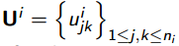
HiCNorm
The Poisson regression in HiCNorm works as follows.
Let represent the Hi-C contact map for chromosome i (n_{i} is the number of 1-Mb bins)
Thus, u_{jk}^{i} represents the number of reads spanning bins L_{j}^{i} and L_{k}^{i}.
We then assume that u_{jk}^{i} allows a Poisson distribution with rate parameter λ_{jk}^{i}

Slide 51
HiCNorm
The value for λ_{jk}^{i} is estimated from the Poisson regression, and the residual: e ˆ_{jk}^{i} is the normalized cis interaction between two bins L _{j} ^{i} and L_{i} ^{k}.
Thus, we obtain a normalized matrix U∗ = {e ˆ_{jk} ^{i}} 1≤j,k≤ni.
This matrix is used for all downstream applications such as that discussed previously in this lecture.

Slide 52
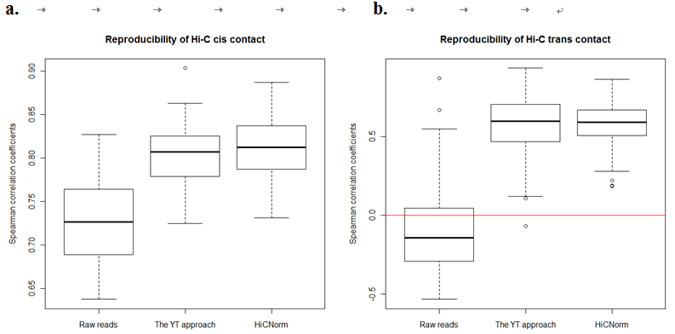
HiCNorm
The authors validated their program in various ways in general the and the computing time for a typical dataset was about.
Reproducibility between experiments was better than that of competing approaches.
Compute speed: 2 seconds compared to about 4 hours for the major competing approach.
Hu M, Deng K, Selvaraj S, et al. HiCNorm: removing biases in Hi-C data via Poisson regression[J]. Bioinformatics, 2012, 28(23): 3131-3133.
Notes:
Reproducibility of the 1D coverage of chromosome 22 (using the trans contact between chromosome 4 and chromosome 22).

Slide 53
Problems
Development of Hi-C
Correlation Analysis
Hi-C on the Chromosome Scale
Hi-C on the Genome Scale

Slide 54
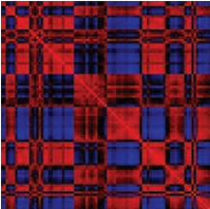
Intrachromosomal proximity map shows two opposing patterns
Chr14
Extremely
Similar!
Opposite
Pattern!
Lieberman-Aiden E, Van Berkum N L, Williams L, et al. Comprehensive mapping of long-range interactions reveals folding principles of the human genome[J]. science, 2009, 326(5950): 289-293.

Slide 55
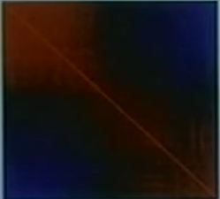
Chromosome 14 has two zones
Zone1
Zone2
Pattern1
Pattern2
Much interaction within zones,
Little interaction between zones.

Slide 56




The whole genome is plaid
Lieberman-Aiden E, Van Berkum N L, Williams L, et al. Comprehensive mapping of long-range interactions reveals folding principles of the human genome[J]. science, 2009, 326(5950): 289-293.

Slide 57

Genomic analysis of Interaction Patterns
The two proximity patterns correlate strongly with open and closed chromatin.
Lieberman-Aiden E, Van Berkum N L, Williams L, et al. Comprehensive mapping of long-range interactions reveals folding principles of the human genome[J]. science, 2009, 326(5950): 289-293.
Pixels:
100Kb²

Slide 58

Model of chromosome structure
Open
Closed
https://vimeo.com/7019500

Slide 59
Problems
Development of Hi-C
Correlation Analysis
Hi-C on the Chromosome Scale
Hi-C on the Genome Scale

Slide 60

Chromosomes occupy distinct territories
3 times
Lieberman-Aiden E, Van Berkum N L, Williams L, et al. Comprehensive mapping of long-range interactions reveals folding principles of the human genome[J]. science, 2009, 326(5950): 289-293.

Slide 61

Some chromosomes cluster together
Lieberman-Aiden E, Van Berkum N L, Williams L, et al. Comprehensive mapping of long-range interactions reveals folding principles of the human genome[J]. science, 2009, 326(5950): 289-293.

Slide 62


Reminder: two intrachromosomal ways of finding zones
Method1: Junctions
Method2: Correlations
Lieberman-Aiden E, Van Berkum N L, Williams L, et al. Comprehensive mapping of long-range interactions reveals folding principles of the human genome[J]. science, 2009, 326(5950): 289-293.

Slide 63

Interchromosomal Map: Like Interacts with Like
https://vimeo.com/7019500
Open interacts with open; closed interacts with closed.

Slide 64

Crude model of genomic structure
All this can be seen with just two lanes.
There is a whole world of fine structure that deeper sequencing will reveal!
Lieberman-Aiden E, Van Berkum N L, Williams L, et al. Comprehensive mapping of long-range interactions reveals folding principles of the human genome[J]. science, 2009, 326(5950): 289-293.

Slide 65

Hi-C data analysis
Forcato M, Nicoletti C, Pal K, et al. Comparison of computational methods for Hi-C data analysis[J]. Nature methods, 2017, 14(7): 679.

Slide 66

Pipeline
Forcato M, Nicoletti C, Pal K, et al. Comparison of computational methods for Hi-C data analysis[J]. Nature methods, 2017, 14(7): 679.
Notes:
Tools for the identification of chromatin interactions and TADs from Hi-C data and key analysis steps (orange arrows)

Slide 67

Fit-Hi-C
a binomial distribution
‘mid-range’ contacts
~50 kb – 10 Mb for human and mouse genome
Ay F, Bailey T L, Noble W S. Statistical confidence estimation for Hi-C data reveals regulatory chromatin contacts[J]. Genome research, 2014.

Slide 68


HiCCUP
Wingett S, Ewels P, Furlan-Magaril M, et al. HiCUP: pipeline for mapping and processing Hi-C data[J]. F1000Research, 2015, 4.
Notes:
HiCUP Digester - creates a digested reference genome
HiCUP - executes sequentially the scripts below
HiCUP Truncater - cuts reads at the putative Hi-C ligation junction
HiCUP Mapper - aligns read pairs independently to a reference genome
HiCUP Filter - removes commonly encountered Hi-C artefacts
HiCUP Deduplicator - removes (retaining one copy) putative PCR duplicates

Slide 69


Fit Hi-C and HiCCUPS for calling loops
http://www.sohu.com/a/232543402_307557
Notes:
2017年发表在Nature Methods上的文章，对10多款分析软件进行了比较分析，在高精度的数据中，HiCCUPS具有最高的保守性。为了更好的展示目前两款主流软件Fit Hi-C和HiCCUPS在call loop分析上的差异，我们进行了实测数据的分析结果对比，见下图。
从这两张对比图中，我们可以明显看出Fit Hi-C 获得的loops数量非常多，特别是近距离的互作，这样很难找到有效的互作位点。相比之下，HiCCUPS可以获得更有效的loops，calling 得到的loops更加准确。因此，对于差异loops分析而言，HiCCUPS更适合。

Slide 70

Summary
Hi-C is cosy and cheap!
Generate our own spatial genome map!
How does structure changes in cancer?
Hi-C specific:
Unbiased, genome-wide
>5M interactions/10M Reads
Resolution (zones): 100Kb/10M Reads
Highly reproducible
Hi-C Analysis:
Correlations
Eigenfold
Hi-C observations:
Chromosomes:
Open and cloesd zones
Nucleus:
Chromosome territories
Small, gene-rich chromosomes cluster
Open and closed zones

Slide 71
Thanks for your attention!

